Slide 1
A project on Data Ingestion and Schema Matching with Delta and PySpark in Databricks
Asawir Jinabade (2136096@Cognizant.com)

Slide 2
Introduction:
This project showcases the use of Databricks, Delta, PySpark, and CSV files for data processing.
The objectives include data ingestion from CSV files, schema matching, and utilizing Delta for efficient data storage.

Slide 3
Databricks Platform:
Databricks is a collaborative cloud-based platform for big data processing and machine learning.
Key features include scalable compute, collaborative notebooks, and integrated data processing capabilities.
It simplifies data engineering and analysis tasks and seamlessly integrates with Spark.

Slide 4
Delta:
Delta is a storage format and processing engine built on Apache Spark, offering ACID transactions and schema enforcement.
It provides support for streaming and batch processing, along with time travel capabilities for data versioning.
Delta enhances data reliability, consistency, and simplifies data pipeline development.

Slide 5
PySpark:
PySpark is the Python library for Apache Spark, enabling scalable distributed data processing.
It offers a high-level API for DataFrame operations, SQL querying, and machine learning algorithms.
PySpark leverages the power of Spark's distributed computing for efficient data analysis.

Slide 6
CSV (Comma-Separated Values):
CSV is a widely-used file format for storing structured data in a tabular format.
It is text-based, easy to read/write, and compatible with various tools and systems.
CSV files facilitate data ingestion, transformation, and exchange between different platforms and applications.

Slide 7
Project Implementation:
The project demonstrates reading data from CSV files, performing schema matching, and utilizing Delta tables for efficient data storage.
Key steps include handling variations in data columns, and leveraging PySpark's data processing capabilities.
The project showcases effective data ingestion and manipulation techniques using Databricks, Delta, and PySpark.

Slide 8
Results and Key Learnings:
The project achieved successful data ingestion, schema matching, and utilization of Delta for efficient storage and analysis.
Key learnings include handling data inconsistencies, optimizing data processing workflows, and ensuring data reliability.
Overcoming challenges led to insights on leveraging Databricks, Delta, PySpark, and CSV files for effective data workflows.

Slide 9
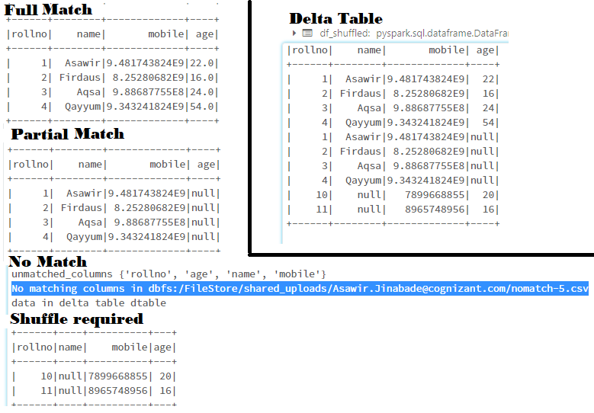
Output

